Slide 1
WHO Implementation Tool for Pre-Exposure Prophylaxis (PrEP) of HIV Infection Online Learning Resource Package
10th Annual International AIDS Society
WHO Satellite: PrEP and STIs – Opportunities and Challenges
Jason Reed, Jhpiego (Jason.reed@jpiego.org)
July 21, 2019

Slide 2
What is the PrEP eLearning Tool for Clinicians?
Training tool for clinicians that is self-paced and interactive via the internet; free to everyone
Aligned specifically with content from the WHO Implementation Tool for PrEP of HIV, Clinical Module
Divided into 4 lessons, each taking approximately 45-60 mins
Includes interactive, engaging visuals and narration accessible from computer and smart phones with internet access and audio
www.hivoralprep.org

Slide 3
How is the PrEP eLearning Tool Structured?
Course Overview
Pre-test
Lesson 1: Identifying Suitable PrEP Candidates
Lesson 2: Starting and Managing PrEP (exact title of abbreviated description)
Lesson 3: Special Situations Arising in Clients (exact title of abbreviated description)
Lesson 4: Counseling and Effectiveness and Safety, and Avoiding Stigma (exact title of abbreviated description)
Post-Test
Certificate of Completion
Each Lesson Includes:
Technical content
Knowledge checks interspersed
Quiz at the end
www.hivoralprep.org

Slide 4
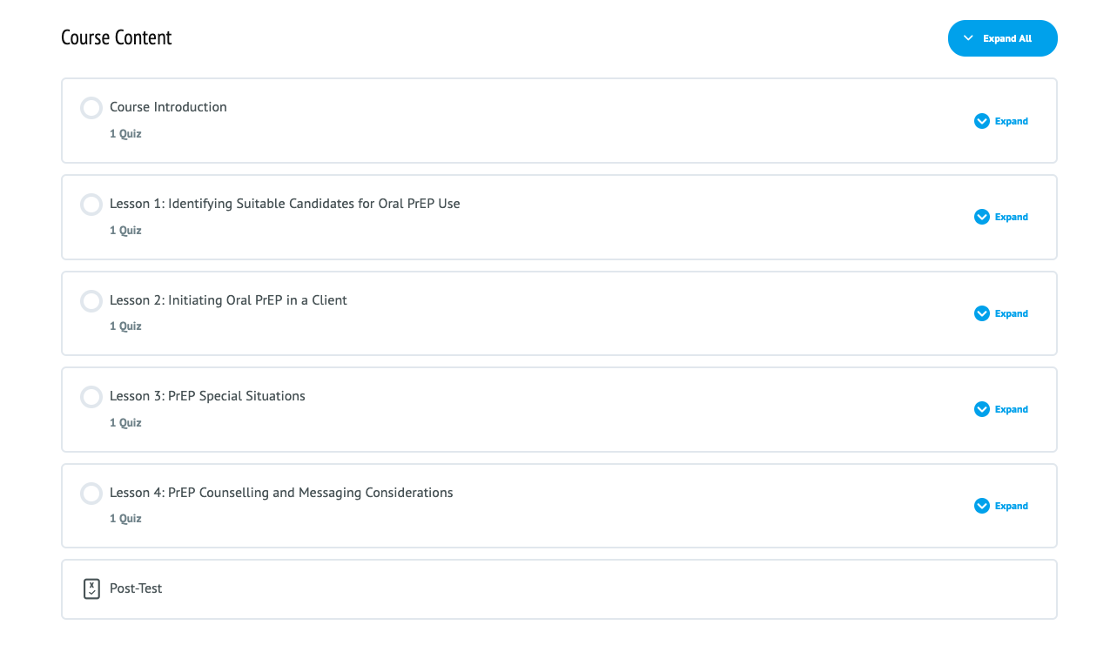
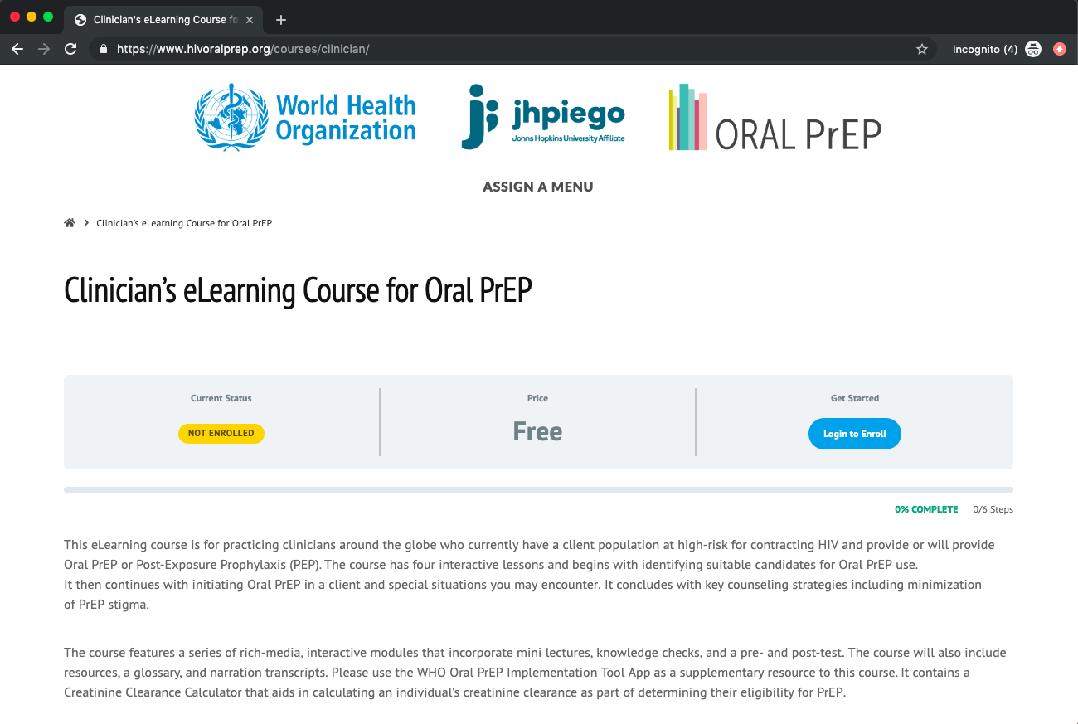
www.hivoralprep.org/courses/clinician

Slide 5
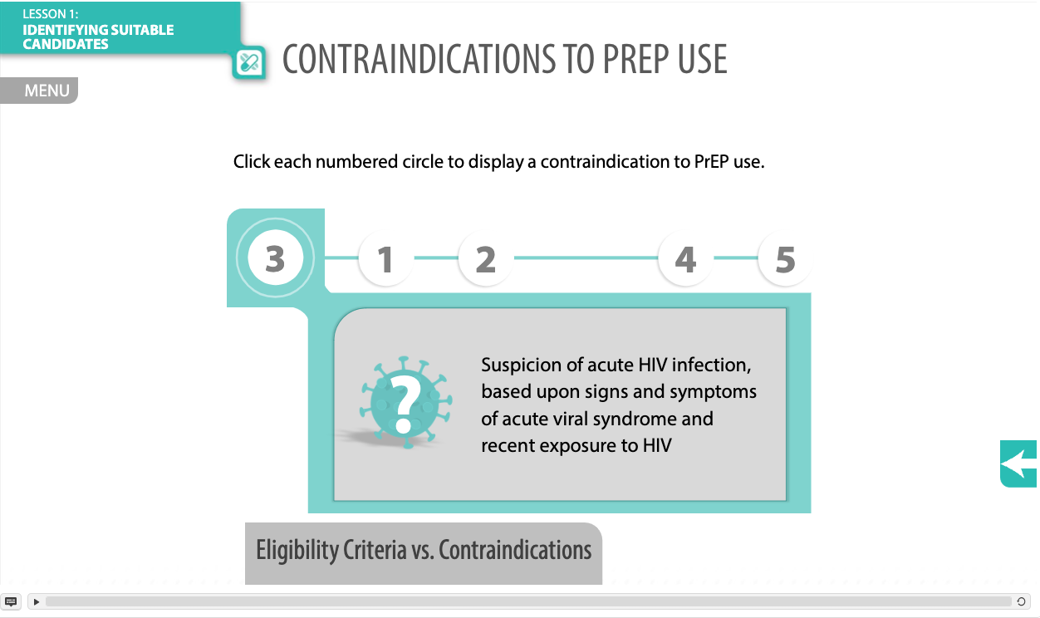
Lesson 1: Determining Eligibility
www.hivoralprep.org/courses/clinician

Slide 6
Lesson 2: Initiating clients on PrEP
www.hivoralprep.org/courses/clinician

Slide 7
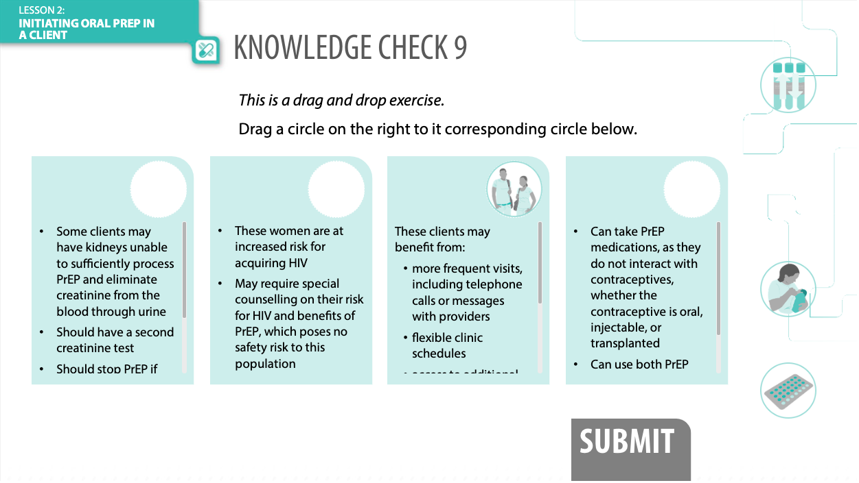
Lesson 3: Special Clinical Situations
www.hivoralprep.org/courses/clinician
Clinically managing special situations arising (double check these bullet points for match with verbiage of the Lesson objectives by Margo)

Slide 8
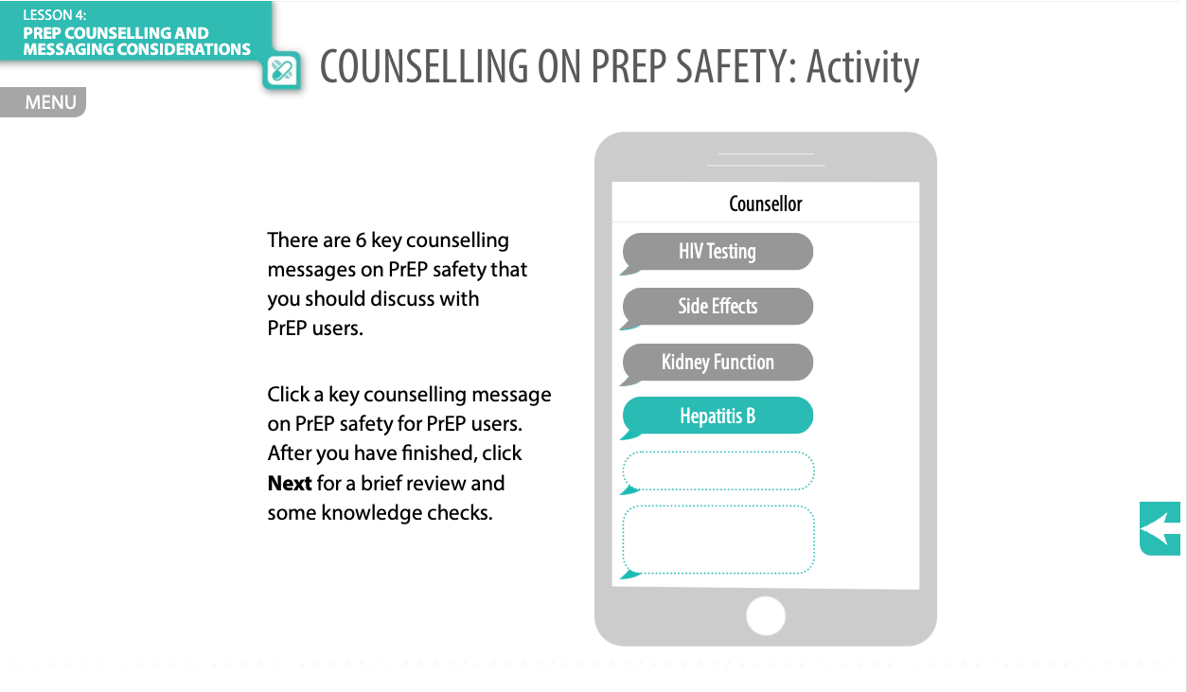
Lesson 4: Counseling Clients/Avoiding Stigma
www.hivoralprep.org/courses/clinician
Counseling clients on PrEP safety (double check these bullet points for match with verbiage of the Lesson objectives by Margo)
Counseling clients on PrEP effectiveness
Reducing stigma for clients

Slide 9
Training Tool Complemented by App
www.hivoralprep.org

Slide 10
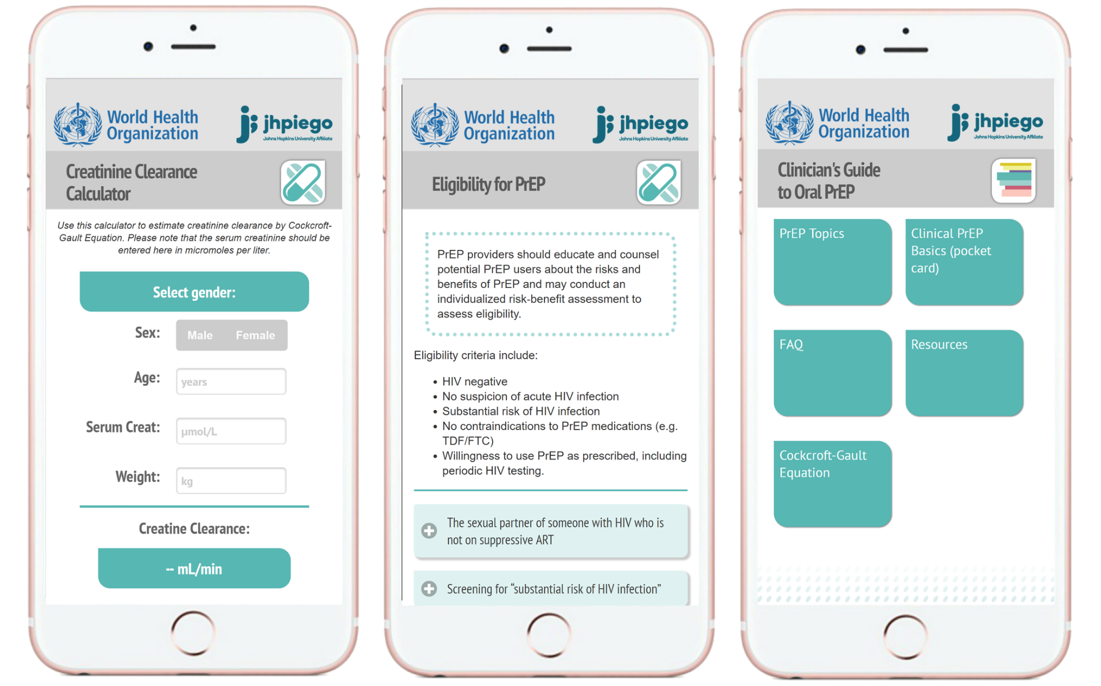
Training Tool Complemented by App
www.hivoralprep.org

Slide 11
Additional Details & Stay Tuned
Online options for clinicians to provide feedback on content and functionality
Aggregate performance to be monitored for problematic knowledge check and quiz questions
Technical updates based upon user feedback and WHO updates in late 2019 and mid-2020
English version available now at: www.hivoralprep.org/courses/clinician
Spanish version in development with plans for other translations
Dissemination plans underway in coordination with WHO and PAHO to inform health ministries and programs of resources
www.hivoralprep.org

